Slide 1
Estimating Water Needs of Urban Landscapes
Dennis Pittenger and David Shaw
University of California Cooperative Extension
Center for Landscape & Urban Horticulture
Los Angeles County/U.C. Riverside/San Diego County
Copyright © Dennis R. Pittenger 2010

Slide 2
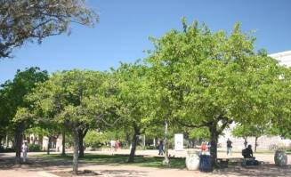
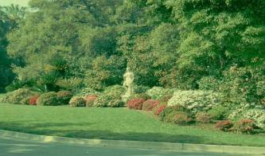

Importance of Landscape Water
Function
Aesthetics
Recreation
Mental Well-being
Center For Landscape & Urban Horticulture
University of California Cooperative Extension

Slide 3
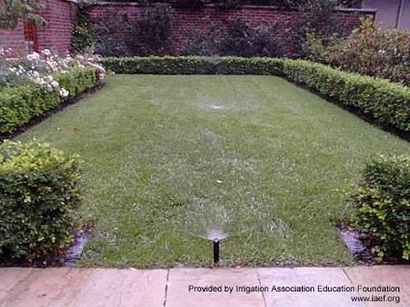
Demand for Climate-based
Plant Water Needs Data
State & local conservation ordinances
Days of week restrictions
Water budgets
Smart irrig’n. controllers
‘Green’ building & development codes
U.S. EPA ‘Water Sense’

Slide 4
Estimating Plant Water Needs
Define a reference for plant water use that is a function of climate
  Reference ET (ETo)
Compare water needed to maintain given plant with reference amount
Express plant water need as % of reference
  Plant Factor (PF)
  Crop Coefficient (Kc)

Slide 5
Assumptions of ETo,
Crop Coefficients & Plant Factors
Plant water need changes in lockstep with changes in ETo
ETo × Kc = Amt. of water needed for optimum growth or yield
ETo × PF = Amt. of water needed for acceptable level of appearance, growth, or function
Center for Landscape & Urban Horticulture
University of California Cooperative Extension

Slide 6
Kc & PF Estimates for Landscape Plants
Turfgrass Kc’s developed
No true Kc’s for landscape plants
Few reliable PFs for landscape plants
WUCOLS & Landscape Coeff. (K_{L})
  Not research-based
Center For Landscape & Urban Horticulture
University of California Cooperative Extension

Slide 7
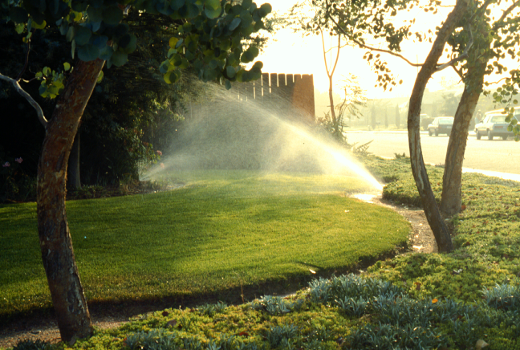
Landscape Plants
Water Use ≠ Water Need
May use more water than needed to meet expectations
PF is a selected from a range of values

Slide 8
Our Research Approach
Minimum water needed for acceptable performance/appearance (%ETo = PF)
Apply multiple % ETo treatments
Irrigate when:
Σ(daily ETo × trtmt. %) = depletion target
Evaluate plant performance
  Aesthetics
  Growth

Slide 9
Field Studies on Landscape Plants’
Water Needs
79 plant species to date
  33 trees, 12 groundcovers, 34 shrubs
Mulch water “use”
Locations – no summer rainfall
  Inland valley – 28 trees
  South Coastal – 28 shrubs, 9 groundcovers, 5 trees
  Low Desert – 6 shrubs, 3 groundcovers
Center for Landscape & Urban Horticulture
University of California Cooperative Extension

Slide 10
General Findings
More water does not always yield better plant performance
Many traditional landscape plants perform acceptably with low amounts of water
Less water often limits growth with limited loss of visual appearance
Many discrepancies with WUCOLS and other sources

Slide 11
Phormium tenax
Aesthetic Quality Ratings
Center for Landscape & Urban Horticulture
University of California Cooperative Extension

Slide 12
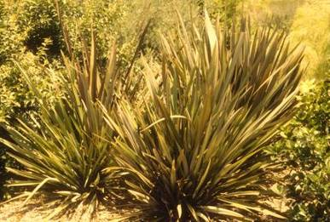
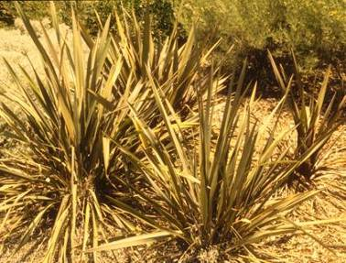
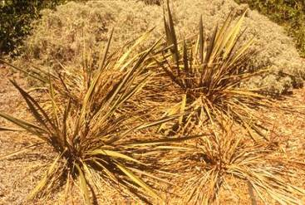
Phormium tenax
Center for Landscape & Urban Horticulture
University of California Cooperative Extension

Slide 13
Raphiolepis indica
Aesthetic Quality Ratings
Center for Landscape & Urban Horticulture
University of California Cooperative Extension

Slide 14
Pyracantha ‘Santa Cruz’
Aesthetic Quality Ratings
Center for Landscape & Urban Horticulture
University of California Cooperative Extension
.

Slide 15
Salvia leucantha
Aesthetic Quality Ratings

Slide 17
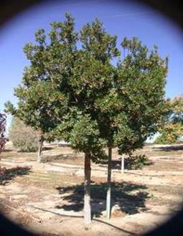
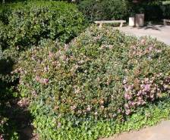
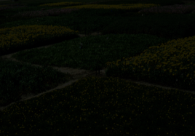
Groundcovers, Trees, Shrubs
Many traditional landscape plants perform acceptably with low amounts of water
Less water often limits growth with limited loss of visual appearance
Acceptable performance 0-80% ETo
Typically acceptable 30-60% ETo
Center For Landscape & Urban Horticulture
University of California Cooperative Extension

Slide 18
Climate-based Water Budgets
Maximum Allowable Water Allocation or Need
MAWA = ETo × PF or Kc × LA × 0.62
Planning tool
Water conservation tool (BMP)

Slide 19
Using & Adjusting PF & Kc Values
Bare
Wet Soil
Turf
G-S-T
Growth
Mulch Freq Sprinkler
C
Mulch
Infreq Drip
W
Limit Growth
Center for Landscape & Urban Horticulture
University of California Cooperative Extension
Center for Landscape & Urban Horticulture
University of California Cooperative Extension
Notes:
19

Slide 20
Take Home
More water does not always yield better plant performance
  Water Use ≠ Water Need
WUCOLS unreliable – false precision
  ≈30% match + ≈ 30% partial match
  ≈ 40% disagreement
Budget 50%-60% ETo for non-turf plantings
  Exact PFs not needed for water budgeting
  Adjust to meet expectations
Center for Landscape & Urban Horticulture
University of California Cooperative Extension

Slide 21
David Shaw dshaw@ucdavis.edu
760-752-4720
Dennis Pittenger
www.ucanr.org.landscapewater
www.ucanr.org.plantfactors
dennis.pittenger@ucr.edu
951.827.3320
Center for Landscape & Urban Horticulture
University of California Cooperative Extension

